Slide 1
Samsung Innovation Campus
Artificial Intelligence Course
Notes:
Note:
1

Slide 2
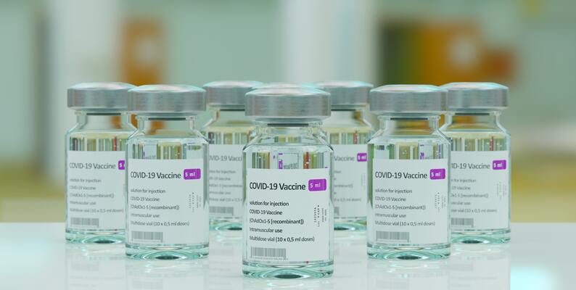
Coronavirus (COVID-19) Vaccinations
COVID-19 | SARS-CoV-2 Pandemic
Project presented by :
Ola Nagi
Marym Magdy Shuky
Omar S. Ibrahim
Moaz Ibrahim AlOmary
Team : Alpha_Go
Data Used : kaggle.com/pavan9065/coronavirus-covid19-vaccinations (42 MB)
Notes:
Note:
2

Slide 3
Agenda
Introduction and Data Description
Data Preprocessing (Wrangling and Cleaning)
Exploratory Data Analysis Using Visualizations (EDA)
Prediction Models
Conclusion and Solutions
Notes:
Note:
3

Slide 4
Introduction.
43.5% of the world population has received at least one dose of a COVID-19 vaccine.
5.98 billion doses have been administered globally, and 28.8 million are now administered each day.
Only 2% of people in low-income countries have received at least one dose.
The mission is to make data and research on the world's largest problems understandable and accessible and to build a predict model teel how much time required until some country is fully vaccinated.

Slide 5
Data Description. Columns Description
Variable
total_vaccinations
people_vaccinated
people.fully.vaccinated
total_boosters
new_vaccinations
Description
Total number of COVID-19 vaccination doses administered
Total number of people who received at least one vaccine dose
Total number of people who received all doses prescribed by the vaccination protocol
Total number of COVID-19 vaccination booster doses administered (doses administered beyond the number prescribed by the vaccination protocol)
New COVID-19 vaccination doses administered (only calculated for consecutive days)

Slide 6
Data Description cont. Columns Description cont.
Variable
new.vaccinations.smoothed
new.vaccinations.smoothed.per.million
people.vaccinated.per_hundred
total.vaccinations.per_hundred
Description
New COVID-19 vaccination doses administered (7-day smoothed). For countries that don't report vaccination data on a daily basis, we assume that vaccination changed equally on a daily basis over any periods in which no data was reported. This produces a complete series of daily figures, which is then averaged over a rolling 7-day window
Total number of COVID-19 vaccination doses administered per 100 people in the total population
Total number of people who received at least one vaccine dose per 100 people in the total population
New COVID-19 vaccination doses administered (7-day smoothed) per 1,000,000 people in the total population

Slide 7
Dropped Columns
total_cases_per_million
new_cases_per_million
total_deaths_per_million
new_cases_smoothed per_million
new_deaths_smoothed_per_million
new_deaths_per_million
icu_patients_per_million
hosp_patients_per_million
weekly_icu_admissions_per_million
weekly_hosp_admissions_per_million
total_tests_per_thousand
new_tests_per_thousand
new_tests_smoothed_per_thousand
total_vaccinations_per_hundred
people_vaccinated_per_hundred
people_fully_vaccinated_per_hundred
total_boosters_per_hundred
new_people_vaccinated_smoothed_per_hundred
new_vaccinations_smoothed_per_million
excess_mortality_cumulative_per_million
new_people_vaccinated_smoothed
stringency_index
handwashing_facilities
hospital_beds_per_thousand
life_expectancy
human_development_index
Columns Removed as there’s no Use for our exploratory analysis .

Slide 8
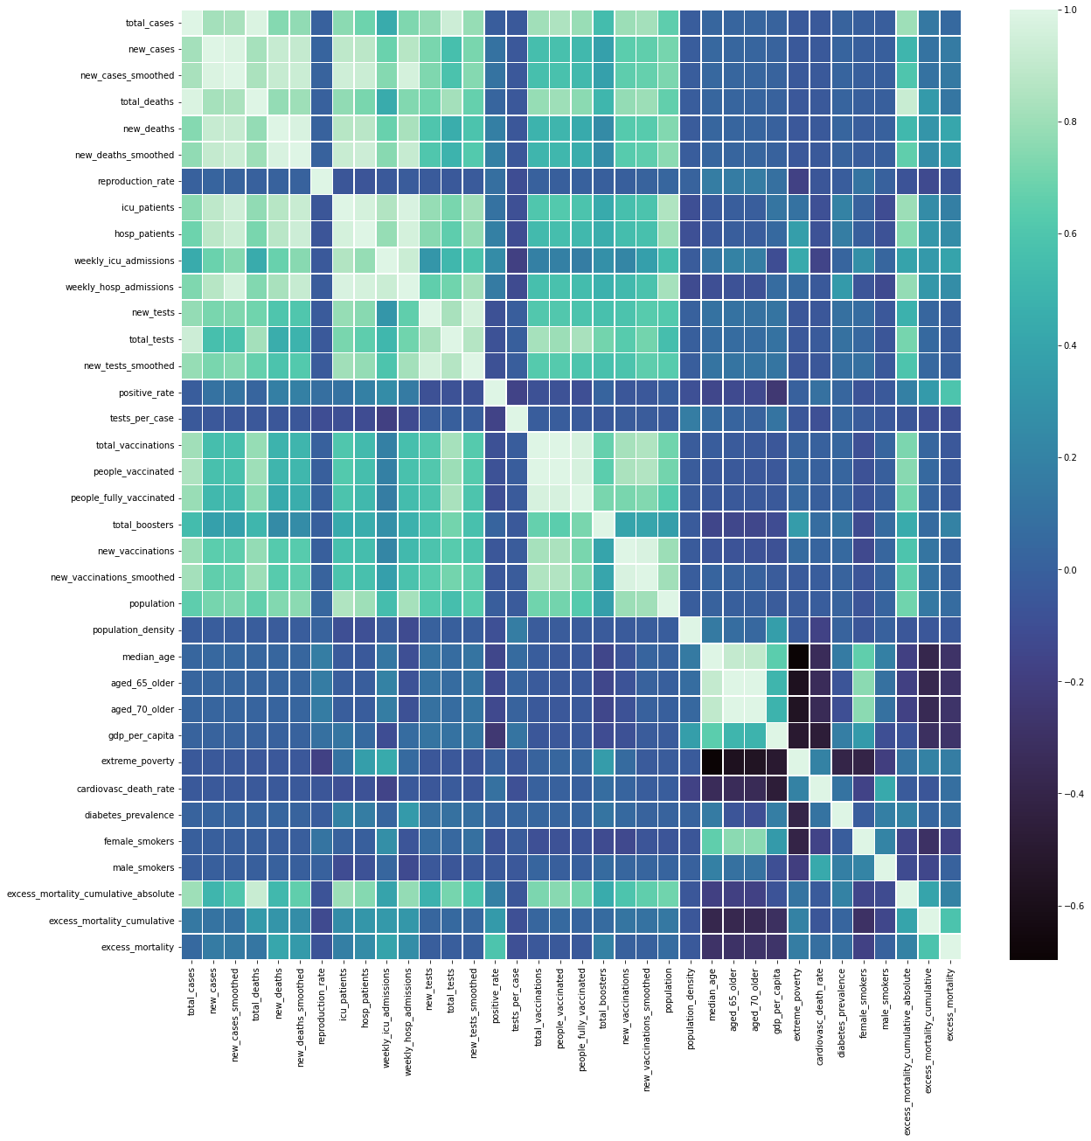
Data Preprocessing. Correlation matrix (Heatmap).
From the we can already see in the heatmap we also can see that some features won't be relevant in our exploratory analysis, as there are too many missing values. Plus, there is so much features to analyze that it may be better to concentrate on the ones which can give us real insights and have high correlation with the study we are conducting. most of these features have NaN percentage of above 80% so it would be more helpful to drop them as well

Slide 9
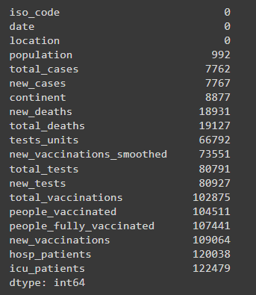
Dataset Description cont. Columns Description cont.
Variable | Null Values Count
iso_code | 0
date | 0
location | 0
population | 992
total_cases | 7762
new_cases | 7767
continent | 8877
new_deaths | 18931
total_deaths | 19127
tests_units | 66792
new_vaccinations_smoothed | 73551
total_tests | 80791
new_tests | 80927
total_vaccinations | 102875
people_vaccinated | 104511
people_fully_vaccinated | 107441
new_vaccinations | 109064
hosp_patients | 120038
icu_patients | 122479

Slide 10
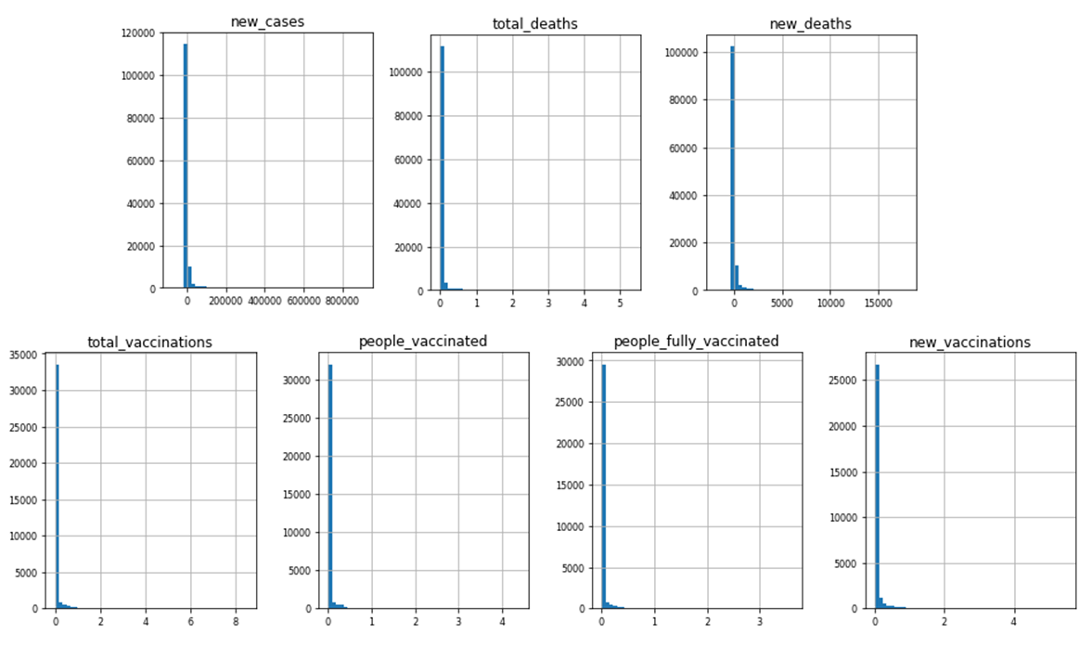
Dataset Description cont. Raw Data Distribution (Histograms)

Slide 11
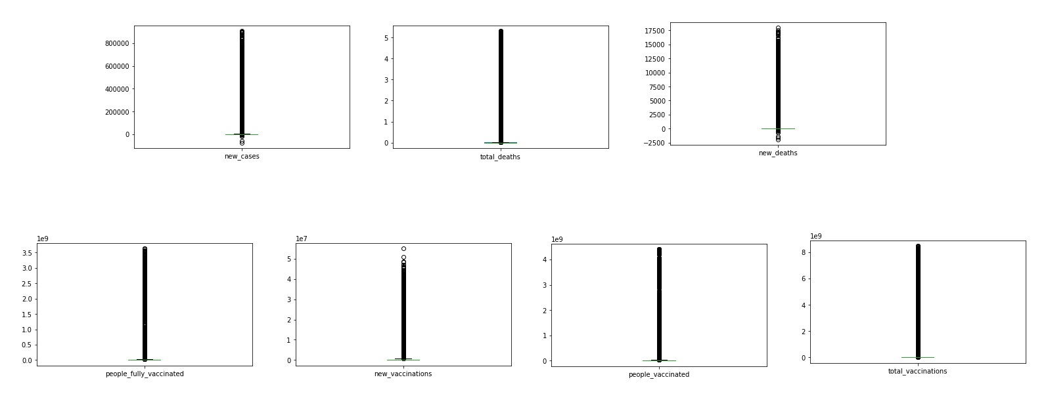
Dataset Description cont. Raw Data Distribution (Box Plots)

Slide 12
Dropped Columns
population_density
median_age
aged_65_older
aged_70_older
dp_per_capita
extreme_poverty
ardiovasc_death_rate
diabetes_prevalence
female_smokers
male_smokers
excess_mortality_cumulative
excess_mortality
reproduction_rate
tests_per_case
positive_rate
new_cases_smoothed
new_deaths_smoothed
new_tests_smoothed
Columns Removed as they’re causing low correlation for the Data and more than 80% are NaNs.

Slide 13
Data Preprocessing. Summary of Data Preprocessing and Cleaning.
First, we dropped the columns mentioned slide above. Because they are not necessary for our analysis.
Then we removed Duplicates, Null Values.
we dropped columns that are duplicated with different scales (in hundreds, thousands...etc) as original cause this would be useless during analysis.
We used Last observation carried forward (LOCF) to fill the missing values.
Finally, we Interpolated the columns values to remove the rest of the all NaNs found.

Slide 14
Data Preprocessing. Summary of Data Preprocessing and Cleaning.
the nature of the distribution of the data is left skewed as the data is decreasing by time naturally that’s why no need to drop the Outliers.
We didn’t find any needs to change any Datatypes.
We just converted the large numbers from scientific notation to regular numbers.
Raw Dataset Shape before Preprocessing is (139589, 67)
Data Shape after Preprocessing is (137270, 16)

Slide 15
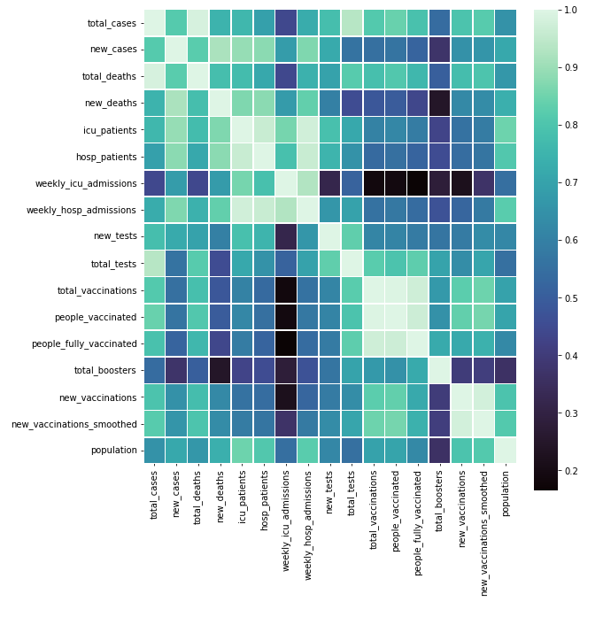

Slide 16
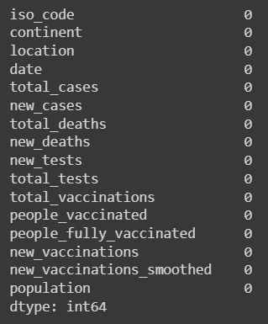
Dataset Description cont. Null Values (NaNs).
Variable | Null Values Count
iso_code | 0
continent | 0
location | 0
date | 0
total_cases | 0
new_cases | 0
total_deaths | 0
new_deaths | 0
new_tests | 0
total_tests | 0
total_vaccinations | 0
people_vaccinated | 0
people_fully_vaccinated | 0
new_vaccinations | 0
new_vaccinations_smoothe | 0
population | 0
iso_code | 0
continent | 0
location | 0

Slide 17
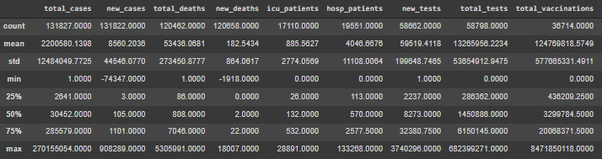
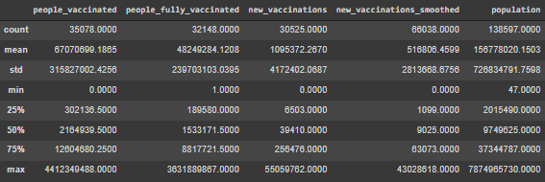
Dataset Description cont. Columns Description cont.

Slide 19
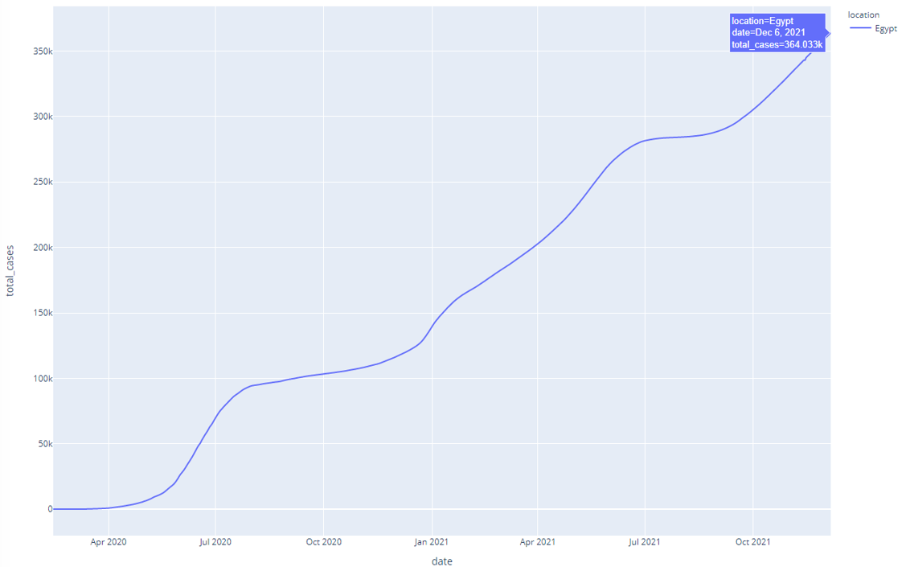
Exploratory Data analysis (EDA). Visualizations.
new cases in egypt
plotly/~aloshism/1

Slide 20
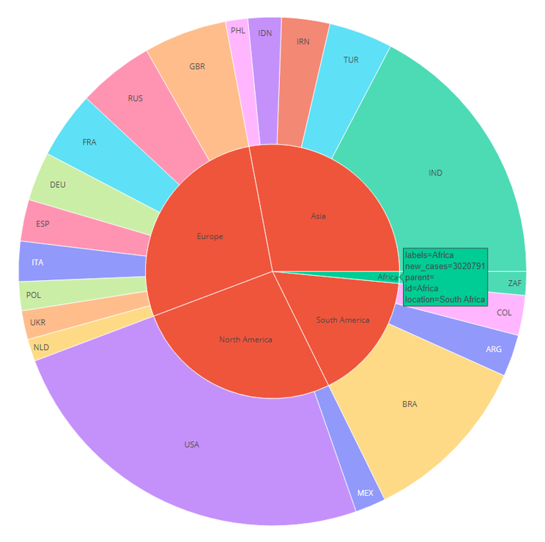
Exploratory Data analysis (EDA). Visualizations.
New cases relative to continent
plotly/~aloshism/8

Slide 21
Exploratory Data analysis (EDA). Visualizations (test_vs_cases).
Total cases in World
plotly/~aloshism/

Slide 22
Exploratory Data analysis (EDA). Visualizations (egypt_daily_vacc).
Total cases in World
plotly/~aloshism/

Slide 23
Exploratory Data analysis (EDA). Visualizations (egypt_full_vaccinations).
vaccination progress in egypt
plotly/~aloshism/15

Slide 24
Exploratory Data analysis (EDA). Visualizations (egypt_cases).
new_cases in egypt
plotly/~aloshism/3

Slide 25
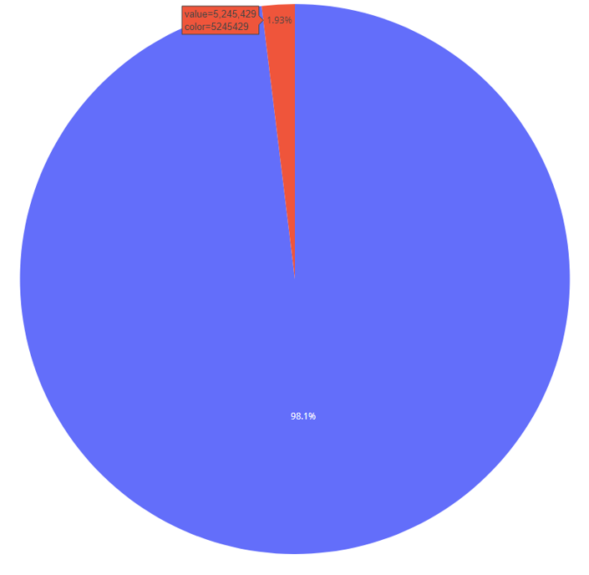
Exploratory Data analysis (EDA). Visualizations.
Percentage of Cases to Death
plotly/~aloshism/18

Slide 26
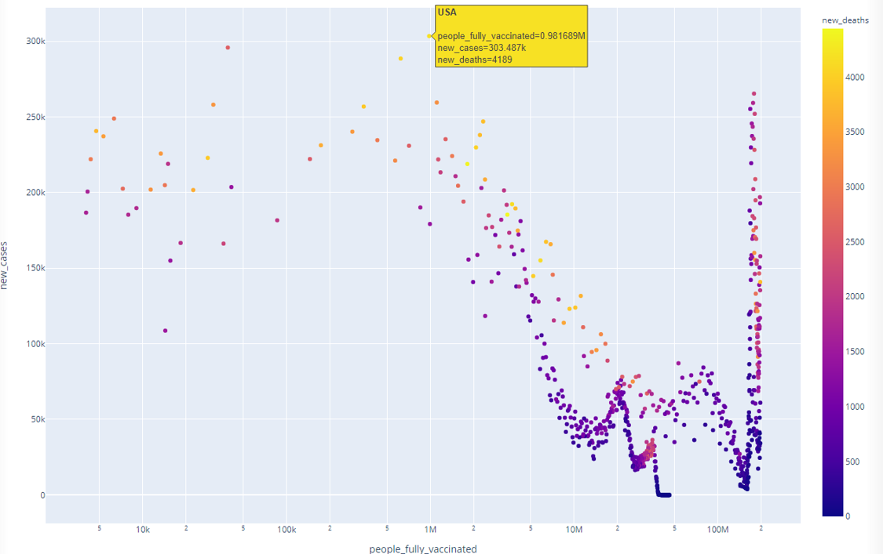
Exploratory Data analysis (EDA). Visualizations.
number of new cases relevance to number of vaccinated
people -Usa plotly/~aloshism/24

Slide 27
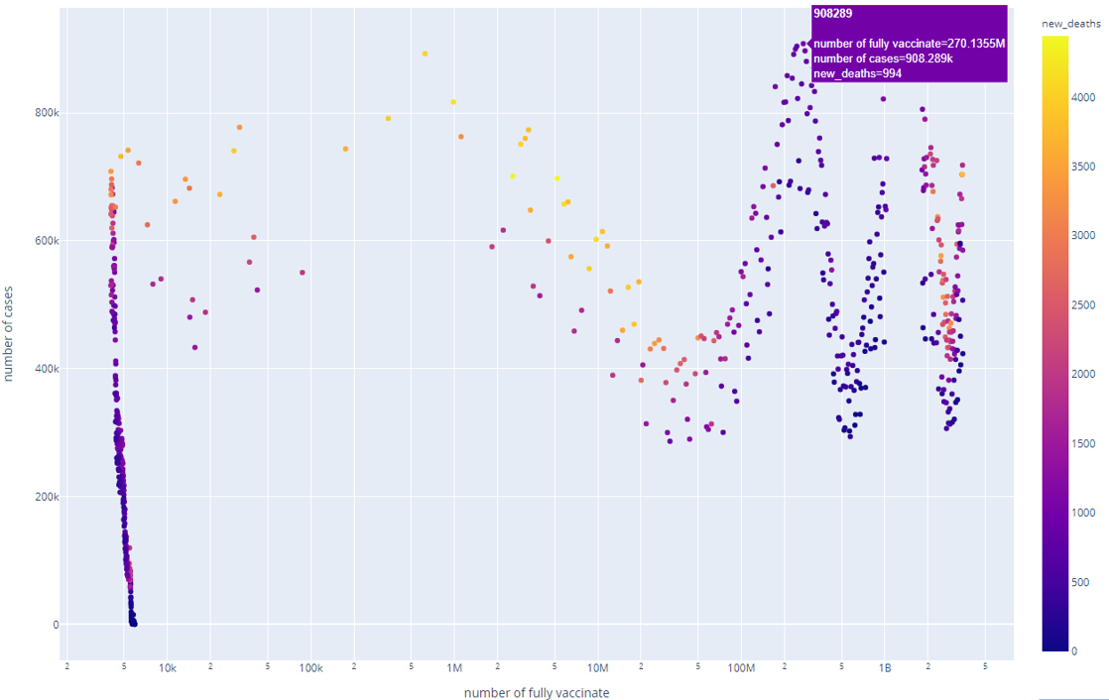
Exploratory Data analysis (EDA). Visualizations.
number of new cases relevance to number of vaccinated
people-WORLD plotly/~aloshism/22

Slide 28
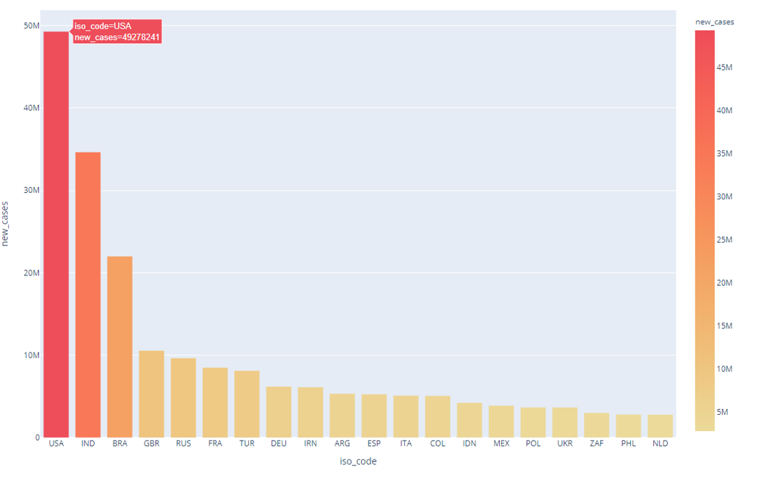
Exploratory Data analysis (EDA). Visualizations.
vaccination in the top 20 countries
plotly/~aloshism/31

Slide 29
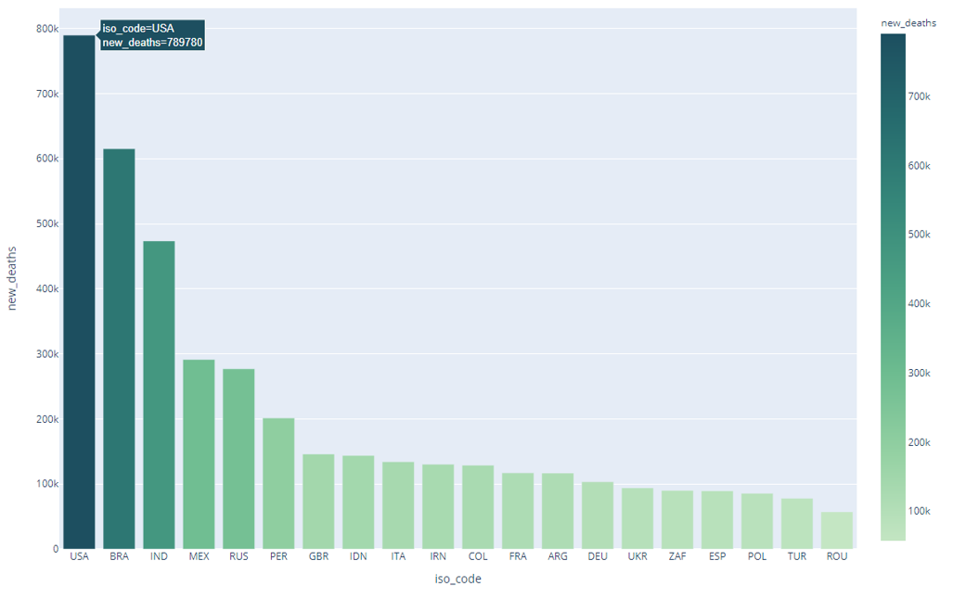
Exploratory Data analysis (EDA). Visualizations
COVID-19 death cases according to countries
plotly/~aloshism/29

Slide 30
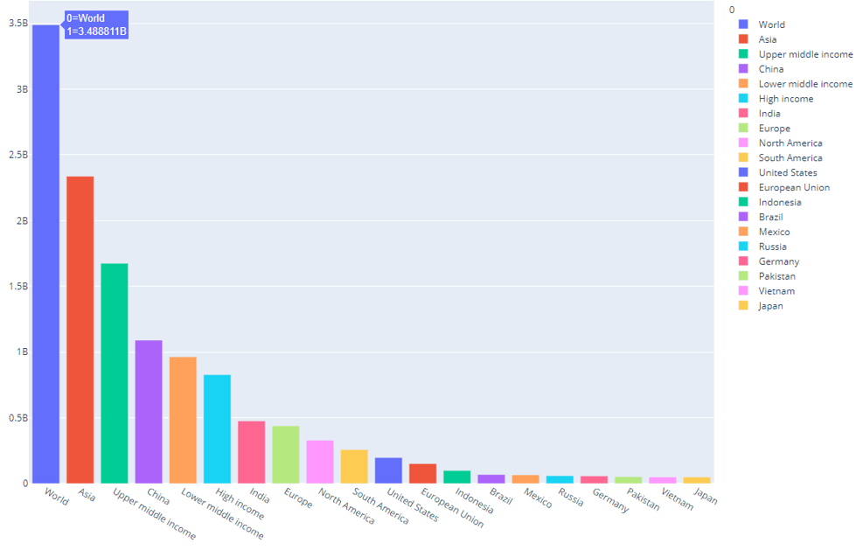
Exploratory Data analysis (EDA). Visualizations.
Numbers of fully vaccinated people in each country
plotly/~aloshism/34

Slide 31
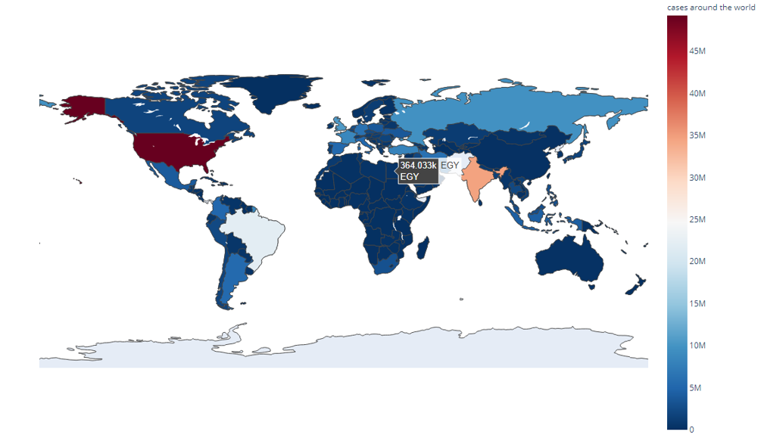
Exploratory Data analysis (EDA). Visualizations (map).
cases around the world
plotly/~aloshism/36

Slide 32
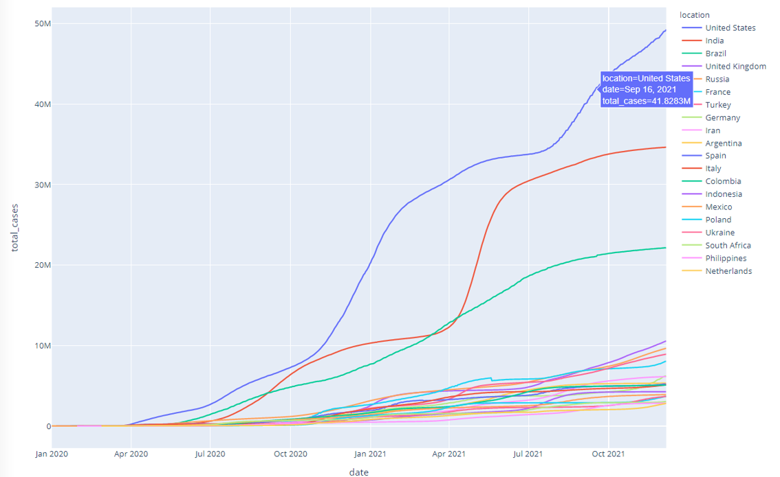
Exploratory Data analysis (EDA). Visualizations.
Top 20 countries in total number cases
plotly/~aloshism/38

Slide 33
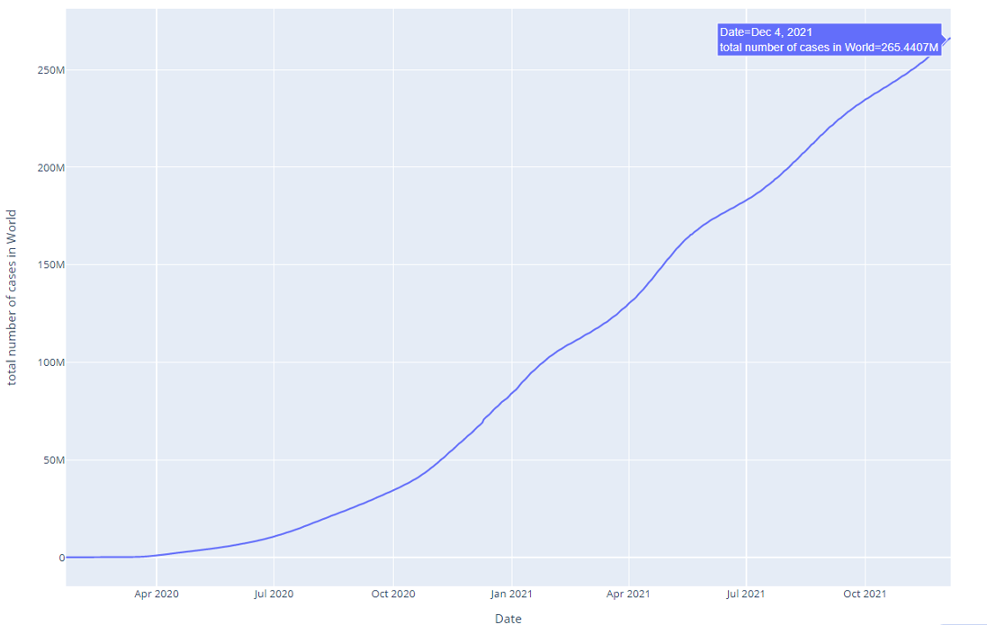
Exploratory Data analysis (EDA). Visualizations.
Total cases in World
plotly/~aloshism/40

Slide 34
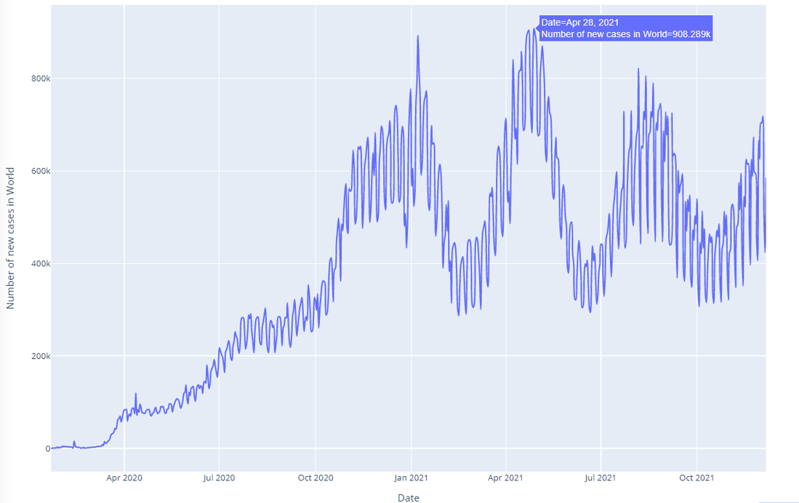
Exploratory Data analysis (EDA). Visualizations.
new cases in World
plotly/~aloshism/42

Slide 35
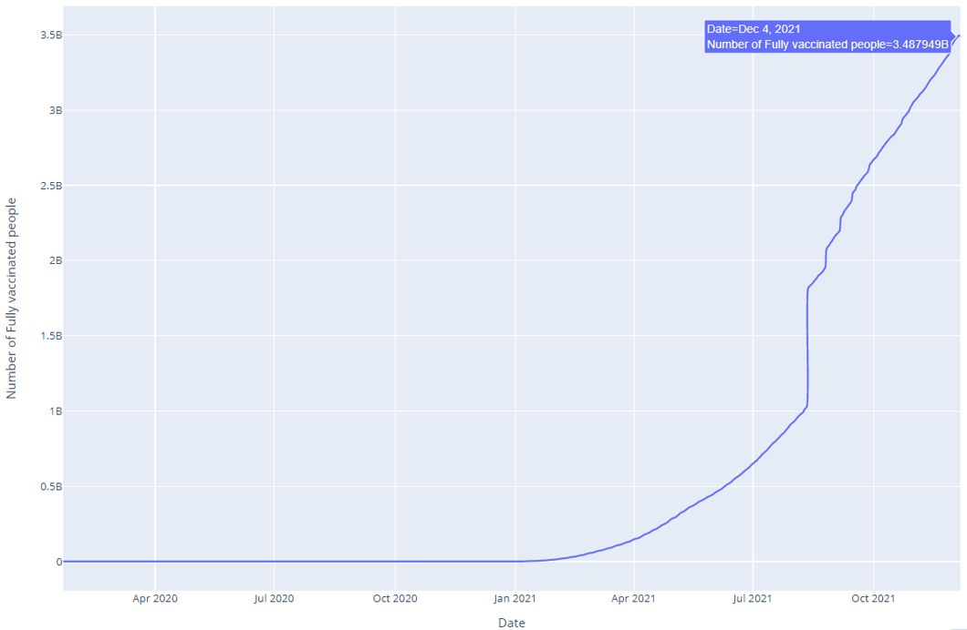
Exploratory Data analysis (EDA). Visualizations.
Fully Vaccinated People around the world
plotly/~aloshism/44

Slide 36
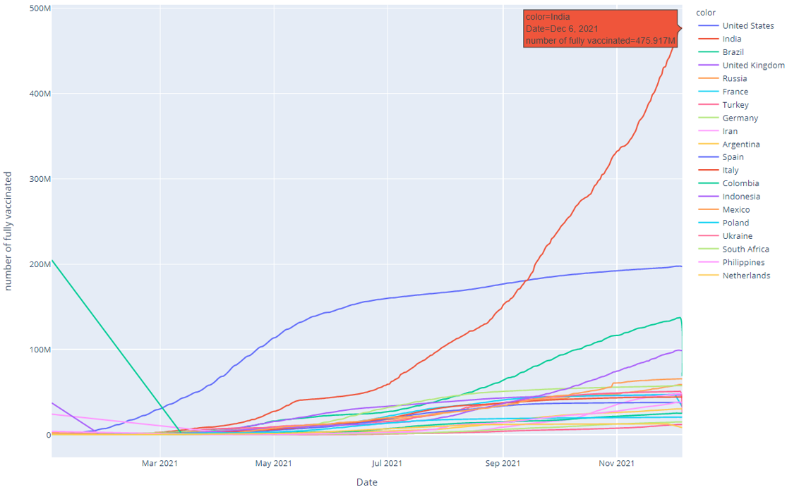
Exploratory Data analysis (EDA). Visualizations.
vaccination in Top 20 countries
plotly/~aloshism/47

Slide 37
Prediction. Models, Constraints & Performance.
Model | Constraints | Performance
Linear Regression | No constraints | Training Accuracy: 0.89707961423 (89.9%) Testing Accuracy: 0.89605459159 (89.1%)
K-nearest-neighbor (KNN) | Neighbors: 15 Sqrt() of 235 rows | Training Accuracy: 0.89707961423 (89.7%) Testing Accuracy: 0.89605459159 (89.6%)

Slide 38
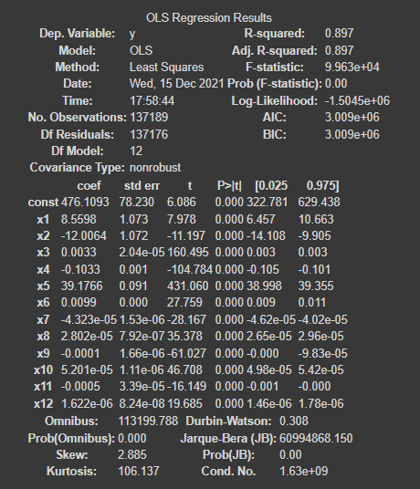
Prediction Model Evaluation. Summary().

Slide 39
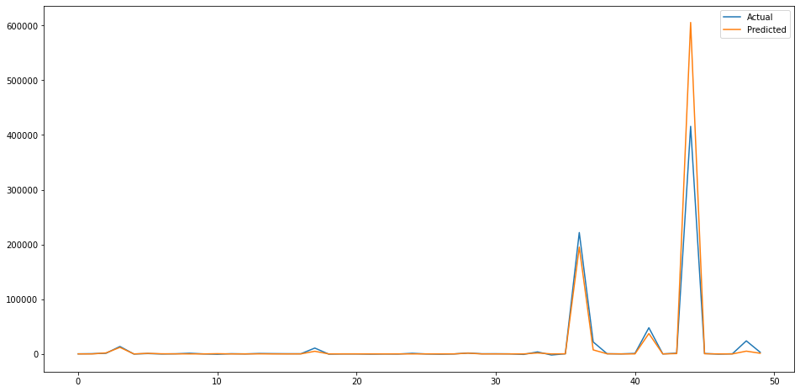
Prediction Model Evaluation. Evaluation Graph (Accuracy Score).

Slide 40
Conclusions and Solutions.
In conclusion, the number of covid-19 cases is affected by many other features that could not be statistically measured.
Like the vaccination type, how well a community is following the rules about social distancing and how governments are dealing with crowded places and special occasions. In addition to the type of the vaccine itself and the different variants that gets discovered every few months.
All of these are variables makes a difference between the actual and predicted values. But in general, the accuracy is high enough to predict future expected results so governments and scientific researchers could deal with expected coming waves and developing better plans for embracing the pandemic and hopefully overcome it

Slide 41
Thank
You…

